Slide 1
CHAPTER 1
Introduction to Services

Slide 2
Chapter Overview
What services are and important trends.
Explain the need for special service marketing concepts and practices (and why this need is accelerating).
Explore the profound impact of technology on service.
Outline the basic differences between goods and services – and the resulting challenges and opportunities for service businesses.
Introduce the expanded marketing mix for services.

Slide 3
Defining Services
    Services are deeds, processes, and performances provided, coproduced or cocreated by an entity or person for and/or with another entity or person.

Slide 4
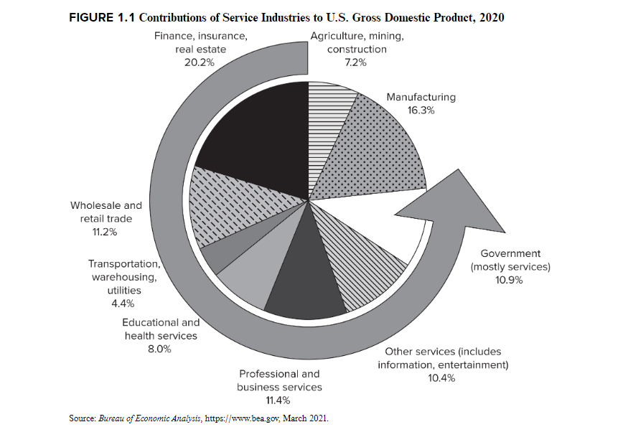
Can you think of examples of firms/ services from these industries?

Slide 5
What are services?
    Service industries and companies: where the core product is a service. Ex: financial services, hospitality.
    Service as a product: intangible product offerings that customers value and pay for in the marketplace. Ex: technology consulting services, gift wrapping services.
    Customer service: service provided in support of a company’s core products. Ex: service provided with technology purchase.
    Derived service: proposes that the value derived from physical goods is really the service provided by the good, not the good itself. Ex: computers provide information and data manipulation services.

Slide 6
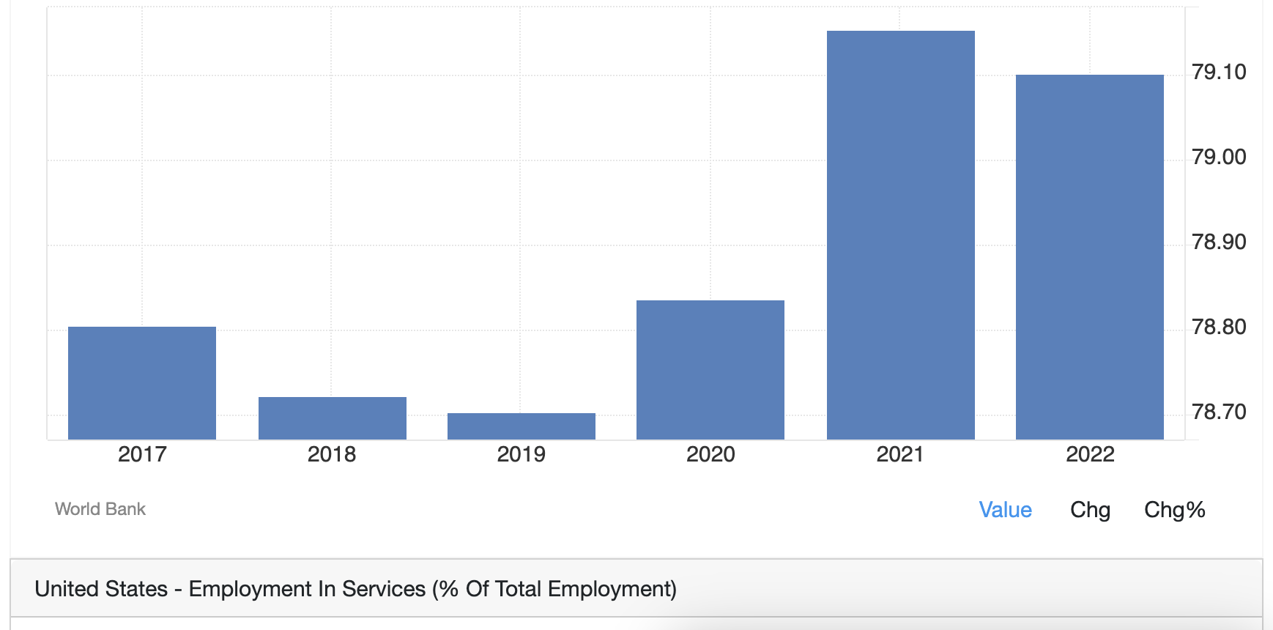
Why study services marketing?
    Service industries represent 79% of total employment in the USA in 2022!
    Service-led growth is now a leading growth strategy.
        Can you think of examples where firms leverage services to drive growth?

Slide 7
Service marketing is different
    Unique challenges that are not common when marketing goods.
        For example, if you depend on an employee to offer good service, how can you manage this and ensure consistently good service?
    Service quality and offerings drive customer loyalty, customer satisfaction, and ultimately profits.
    Competitive strategies include:
        Out-of-the-box customer service
        Innovative / cutting-edge services
        Value-add / revenue-producing services
        Differentiating with service culture

Slide 8
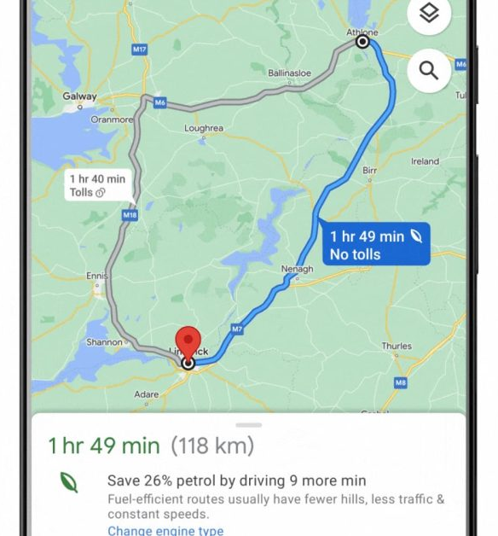
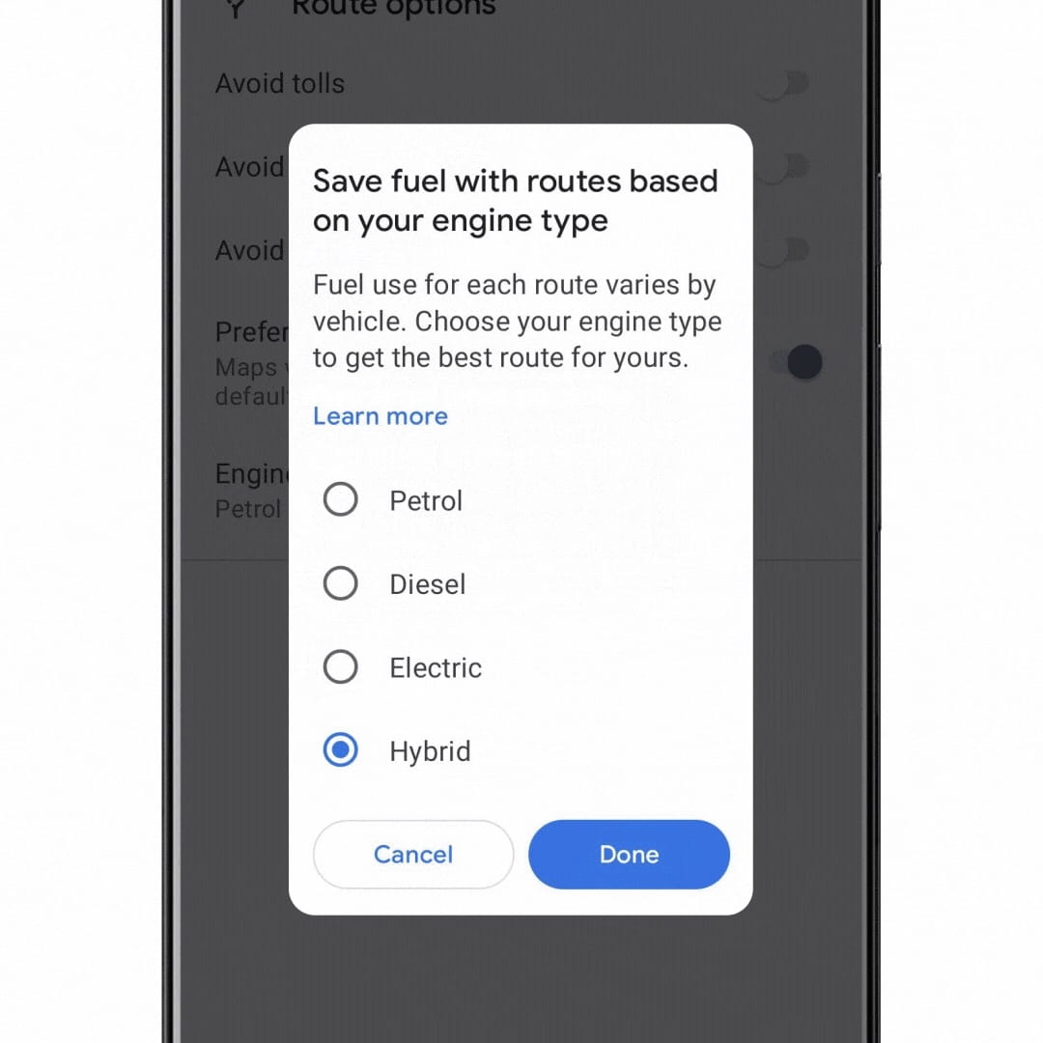
Technology is causing a service revolution
    Companies like MAAMA offer services previously unheard of services.
      Alphabet (Google): Google Maps

Slide 9
Can you think of other examples where technology has transformed a service process?

Slide 10
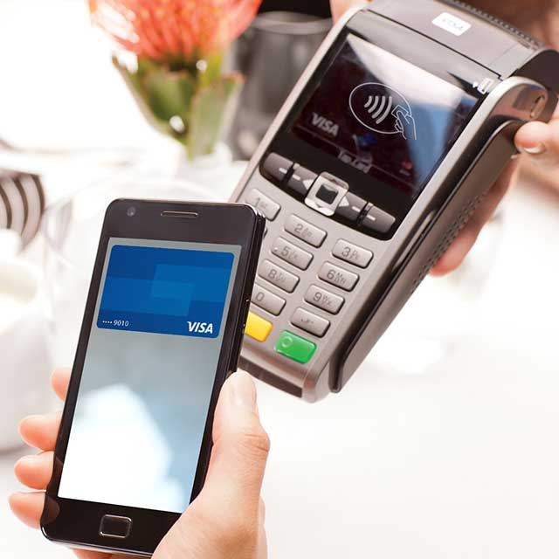


Technology is causing a service revolution
    Smart phones offer innumerable new service applications.

Slide 11
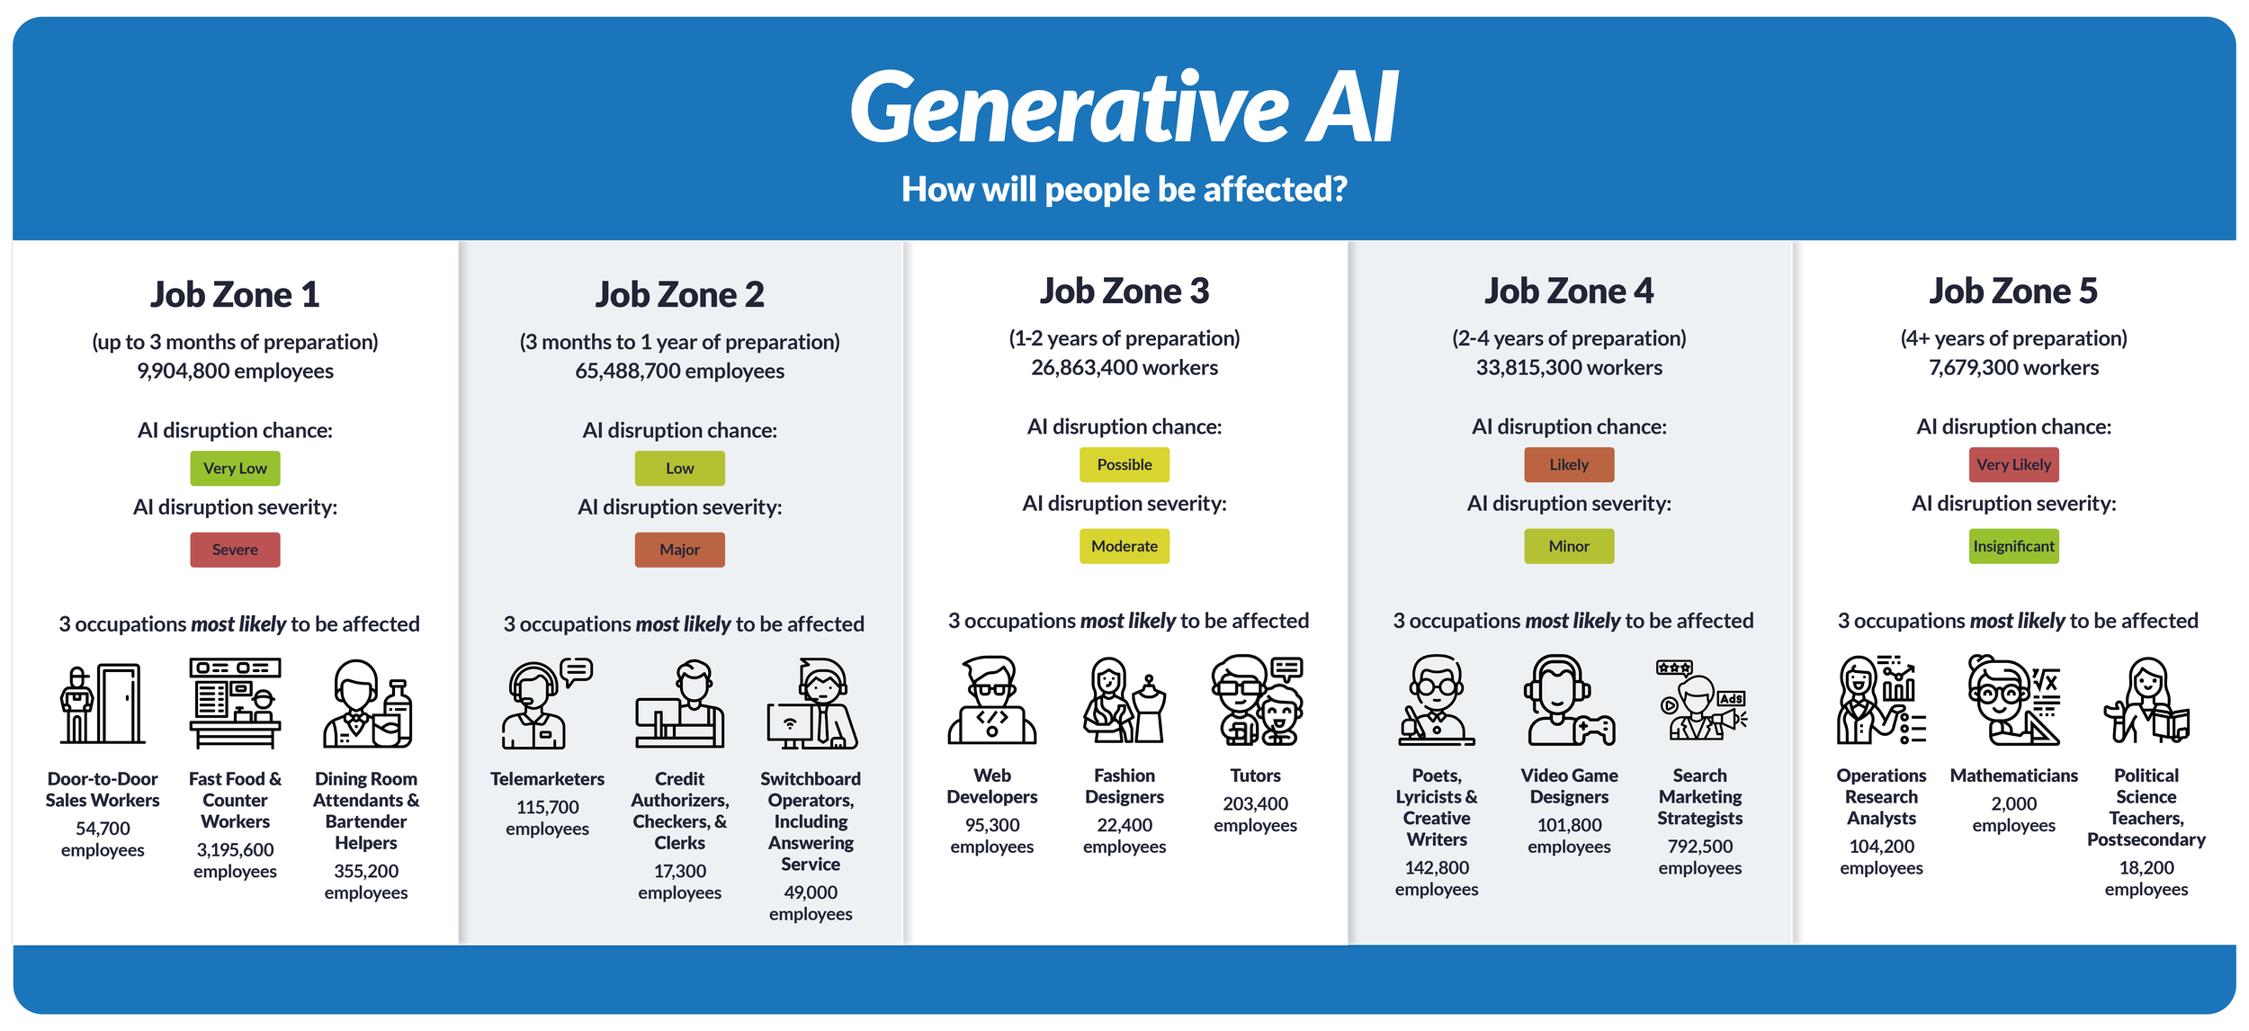
Technology is causing a service revolution
    How will Generative AI affect service jobs?
Source: Moser Consulting

Slide 12
What are your thoughts on Generative AI affecting services/ tasks in an industry you might want to work in?

Slide 13
Differentiating services from goods

Slide 14
Differentiating services from goods
Goods | Services | Resulting Implications
Tangible | Intangible | Services cannot be inventoried. Services cannot be easily patented. Services cannot be readily displayed or communicated. Pricing is difficult.
Standardized | Heterogeneous | Service delivery and customer satisfaction depend on employee and customer actions. Service quality depends on many uncontrollable factors. There is no sure knowledge that the service delivered matches what was planned and promoted.

Slide 15
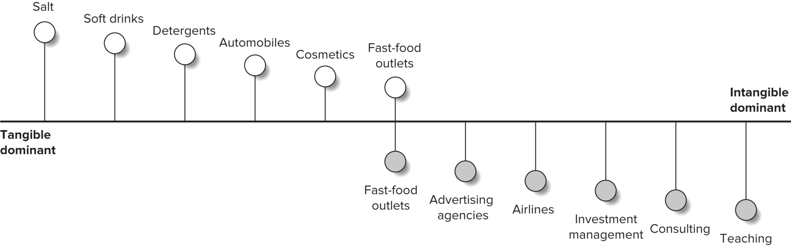
Tangibility Spectrum
Notes:
What do we mean by intangibility? Few products are purely tangible or totally tangible, instead many fall along the spectrum. For example, the fast-food industry, while classified as a service, also has many tangible components such as the good, the packaging and so on.

Slide 16
Differentiating services from goods
Goods | Services | Resulting Implications
Tangible | Intangible | Services cannot be inventoried. Services cannot be easily patented. Services cannot be readily displayed or communicated. Pricing is difficult.
Standardized | Heterogeneous | Service delivery and customer satisfaction depend on employee and customer actions. Service quality depends on many uncontrollable factors. There is no sure knowledge that the service delivered matches what was planned and promoted.

Slide 17
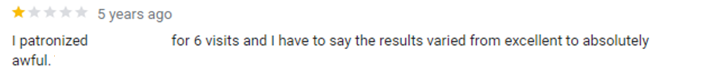

Heterogeneity
Notes:
No two services (even by the same person at the same place) will be precisely alike. Similarly, no two customers are alike. People delivering the service may differ in the customer’s eyes. Heterogeneity is largely a result of human interaction. Delivering consistent quality is challenging.

Slide 18
Differentiating services from goods
Goods | Services | Resulting Implications
Production separate from consumption | Simultaneous production and consumption | Customers participate in and affect the transaction. Customers affect each other. Employees affect the service outcome. Mass production is difficult.
Nonperishable | Perishable | It is difficult to synchronize supply and demand of services. Services cannot be returned and sold. Services for any given time-period cannot be sold or delivered at a later date.

Slide 19


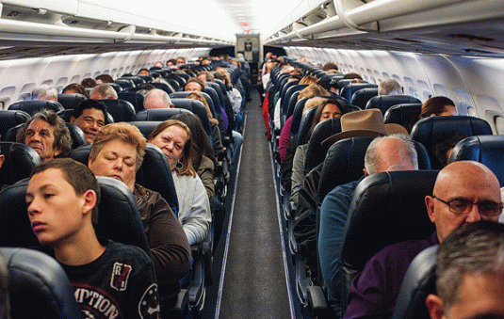
Simultaneous Production and Consumption
Notes:
Customers are present when service is being produced (dining, air travel etc.) taking part as co-creators of service. Customers may also interact with each other affecting their experience.

Slide 20
Differentiating services from goods
Goods | Services | Resulting Implications
Production separate from consumption | Simultaneous production and consumption | Customers participate in and affect the transaction. Customers affect each other. Employees affect the service outcome. Mass production is difficult.
Nonperishable | Perishable | It is difficult to synchronize supply and demand of services. Services cannot be returned and sold. Services for any given time-period cannot be sold or delivered at a later date.

Slide 21
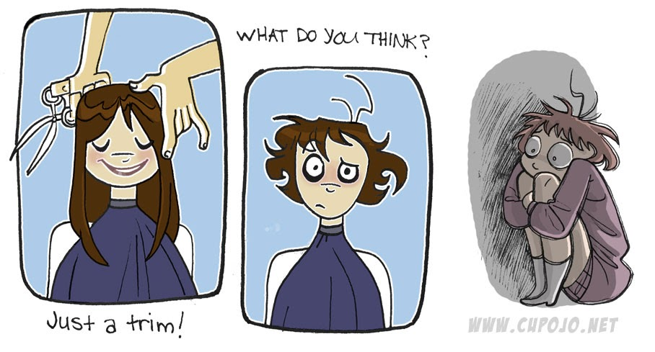
Perishability
Services cannot be stored, saved, returned, or resold once they have been used.
Notes:
Inventory and demand forecasting is difficult. Requires marketers to have a strong recovery strategy in case things go wrong.

Slide 22
Expanded Marketing Mix (the 7Ps)
Product: physical good, packaging, warranties, etc.
Place: channel type(s), locations, storage, etc.
Promotion: salespeople, training, incentives, advertising, etc.
Price: price level, terms, discounts, etc.
People: employees and customers.
Physical Evidence: facility design, business cards, signage, etc.
Process: flow of activities, number of steps, customer involvement.
Notes:
Because services are intangible, customers are often looking for any tangible cue to help them understand the nature of the service experience.

Slide 23

The 4Ps
Source: NBC News

Slide 24
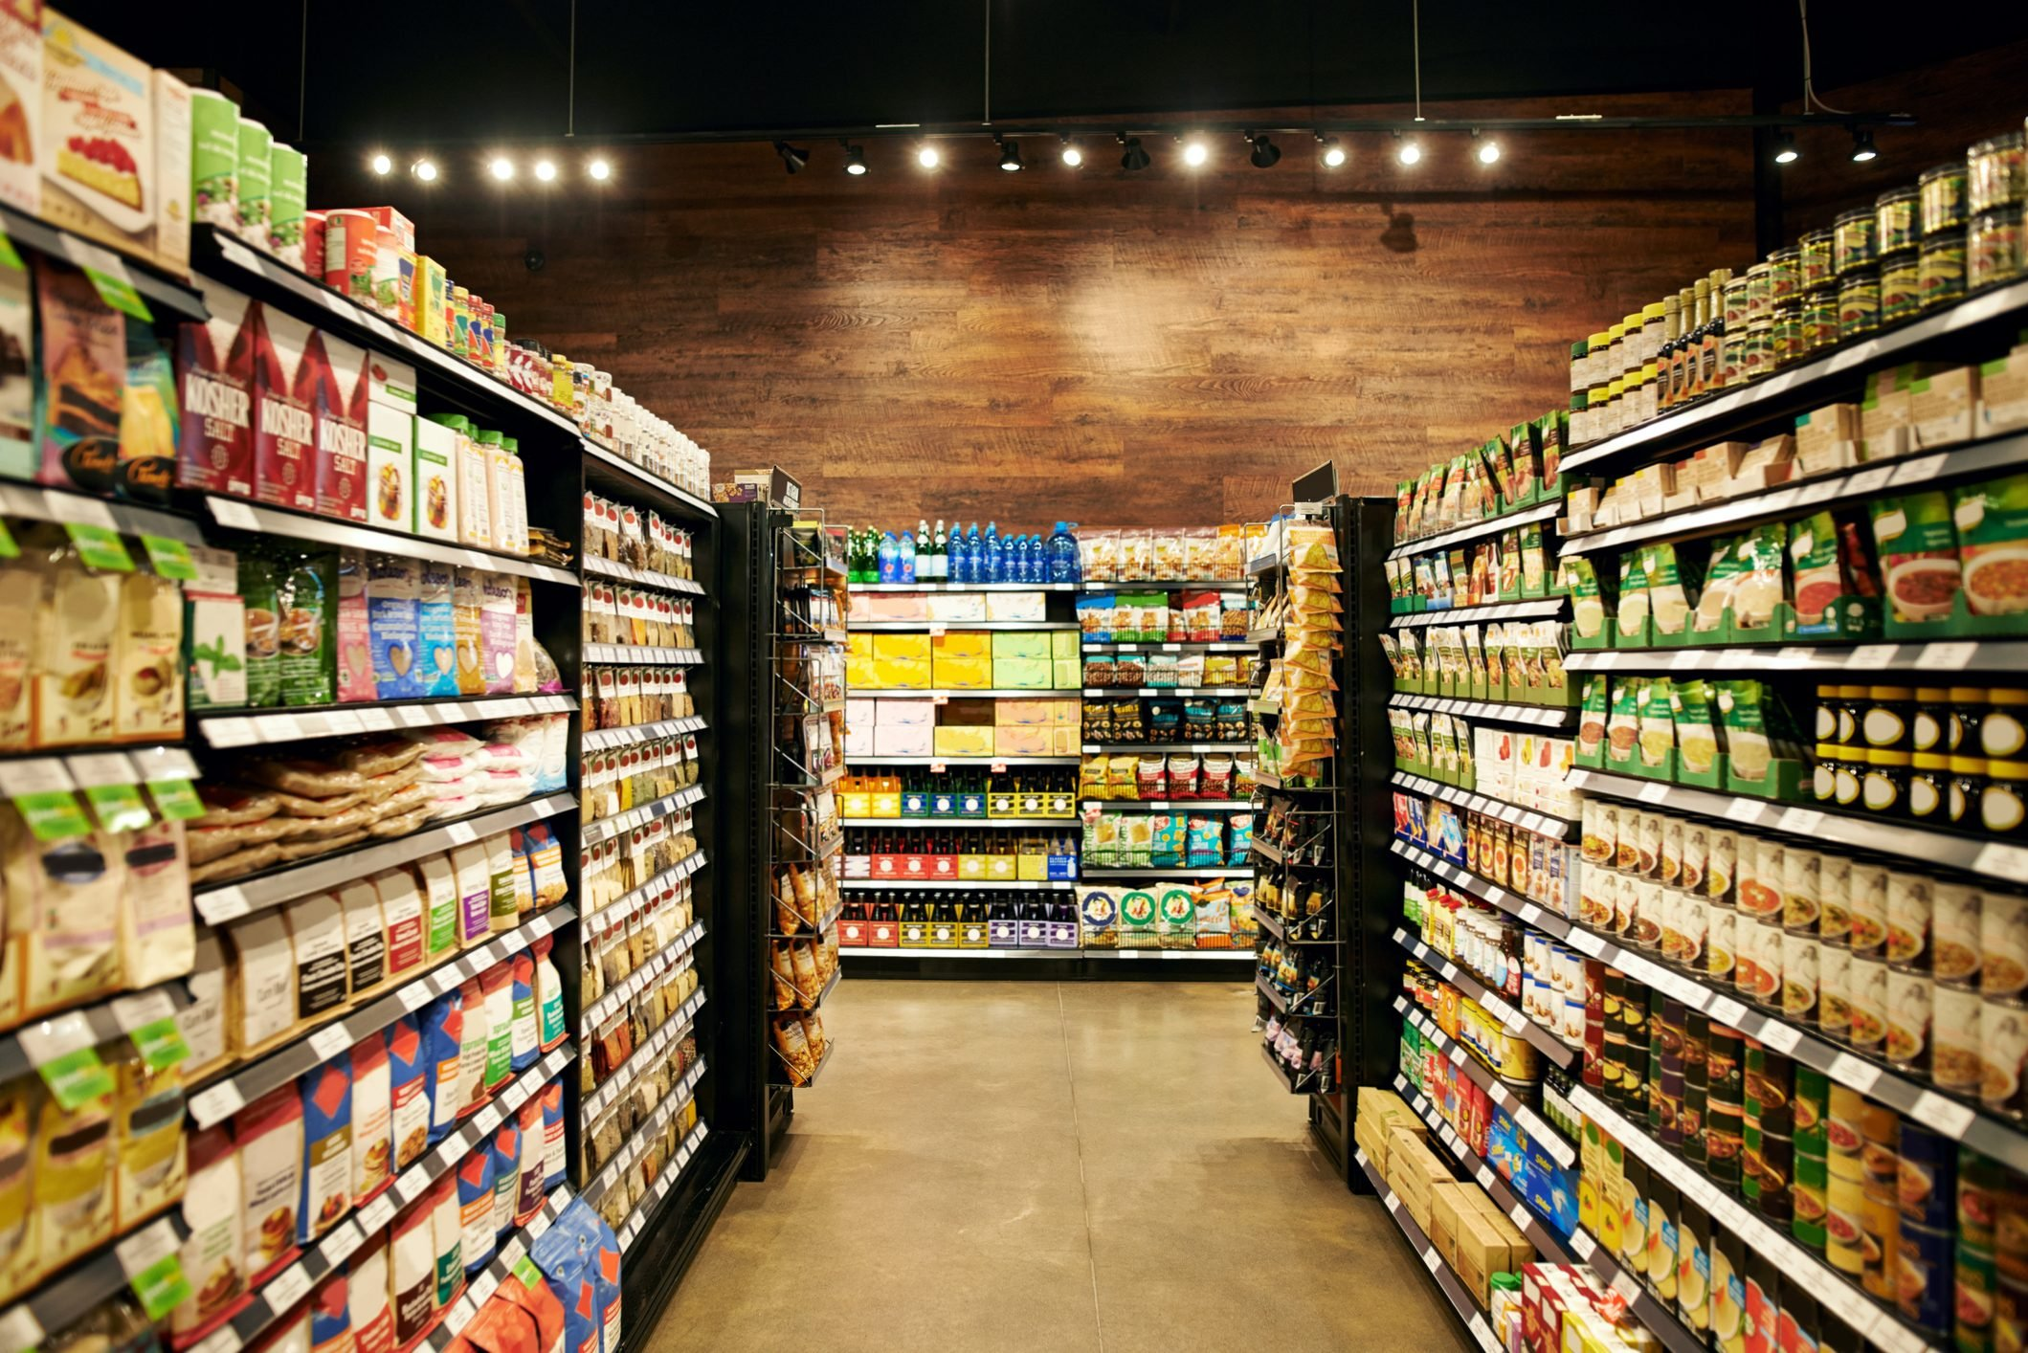
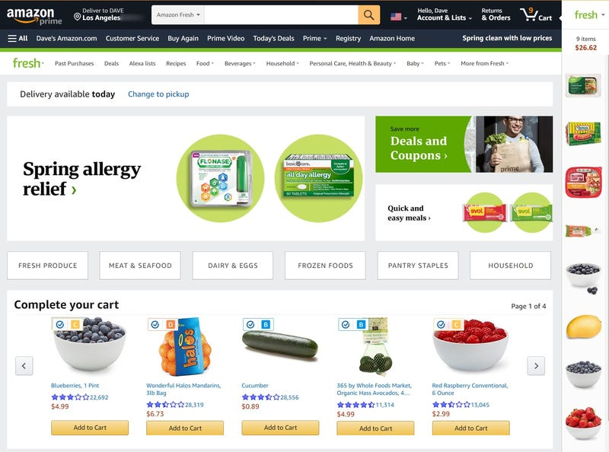
The 4Ps
Source: Supermarket News
Source: Business Insider

Slide 25
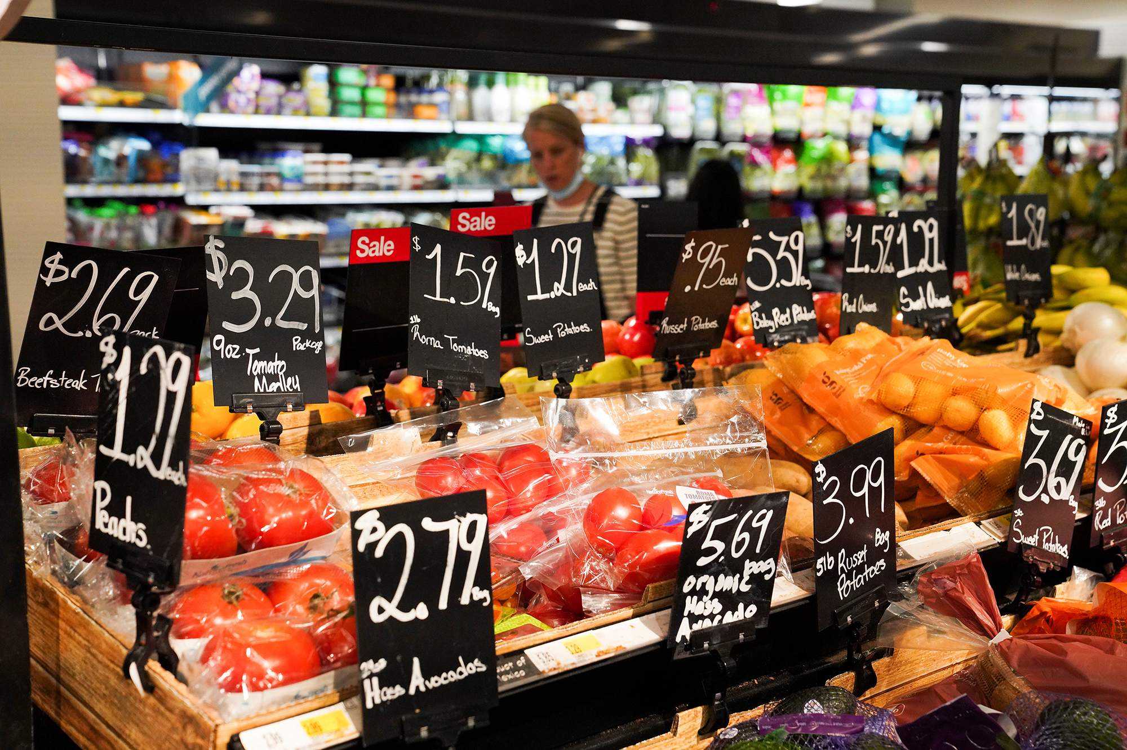
The 4Ps
Source: NY Post

Slide 26
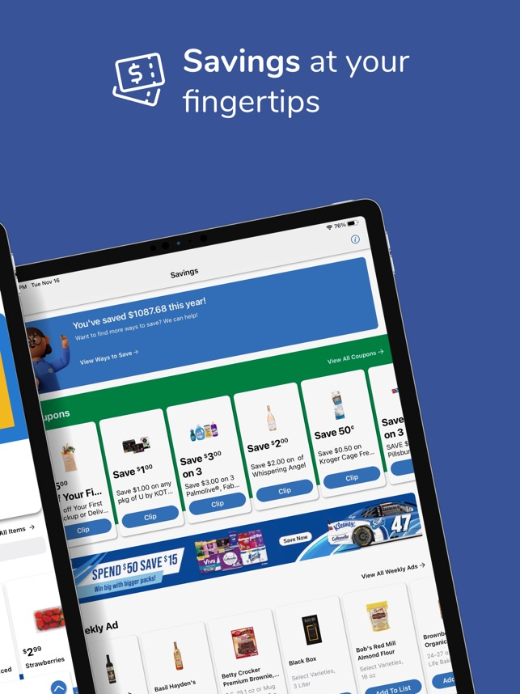
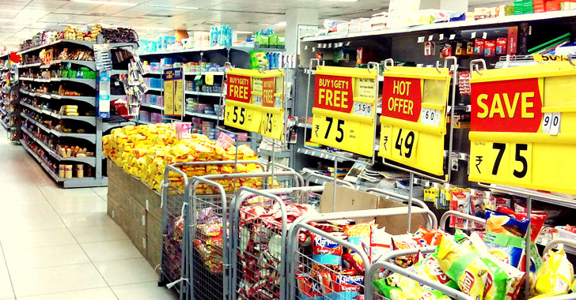
The 4Ps
Source: GoFrugal
Source: Kroger

Slide 27

People
All human actors who play a part in service delivery and thus influences the buyers’ perceptions.
Employees: attitudes and behaviors, dress, appearance, body language – all can influence the customer’s behavior.
Customers: can also influence customer behavior – how do you feel when someone is yelling at / praising an employee?
Source: Inside Retail Asia
Notes:
For some services like consulting, counseling, teaching etc. the provider is the service. Customers can also influence service delivery, affecting service quality and their own satisfaction. Customers can also influence outcomes for other customers, e.g., in a theater.

Slide 28
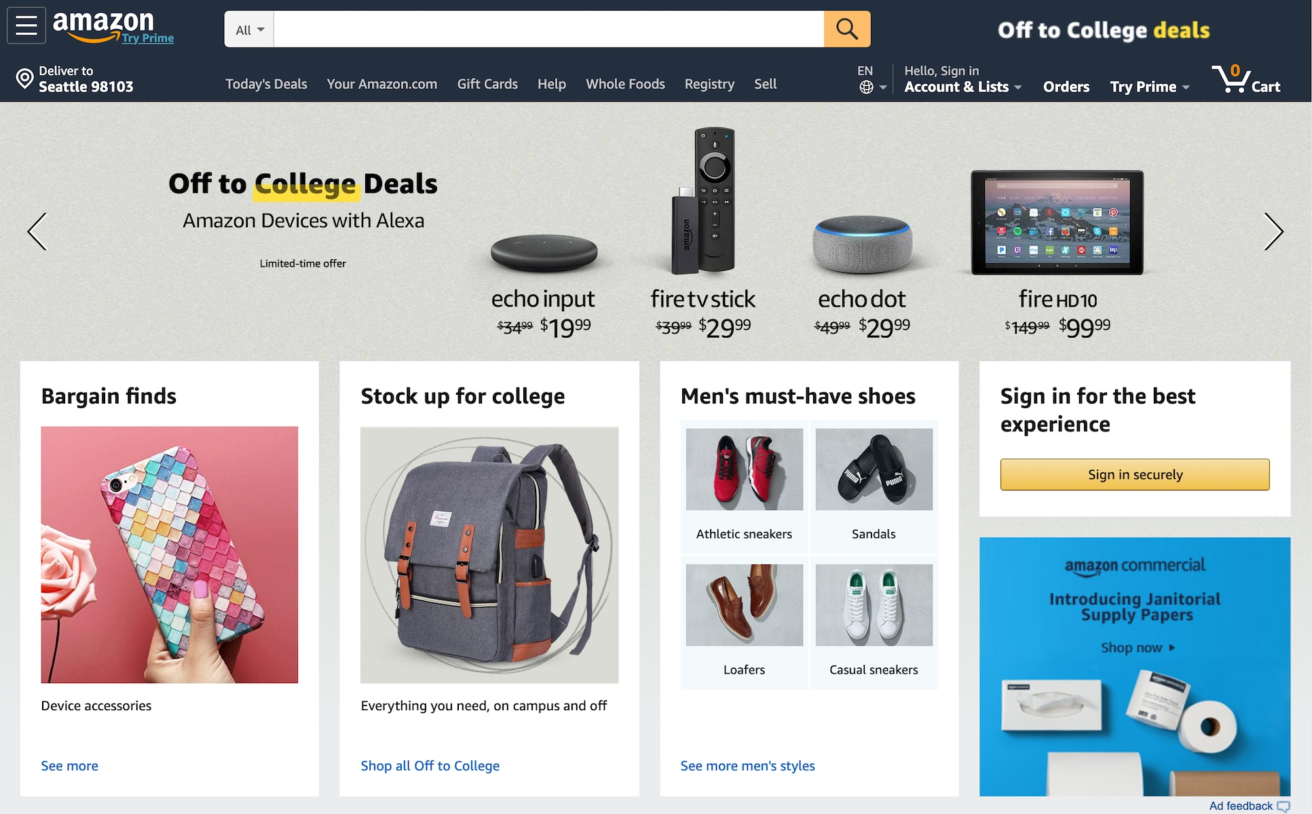
Physical Evidence
The physical and virtual environment in which the service is delivered and where the customer and firm interact.
This includes tangible component that facilitate performance or communication of the service.
When consumers have little to judge the actual quality of service, they will rely on such cues.
Source: Version Museum
Notes:
Physical evidence: brochures, letterheads, signage, equipment, facility where service is offered
Virtual evidence: website, VR interfaces, mobile applications

Slide 29
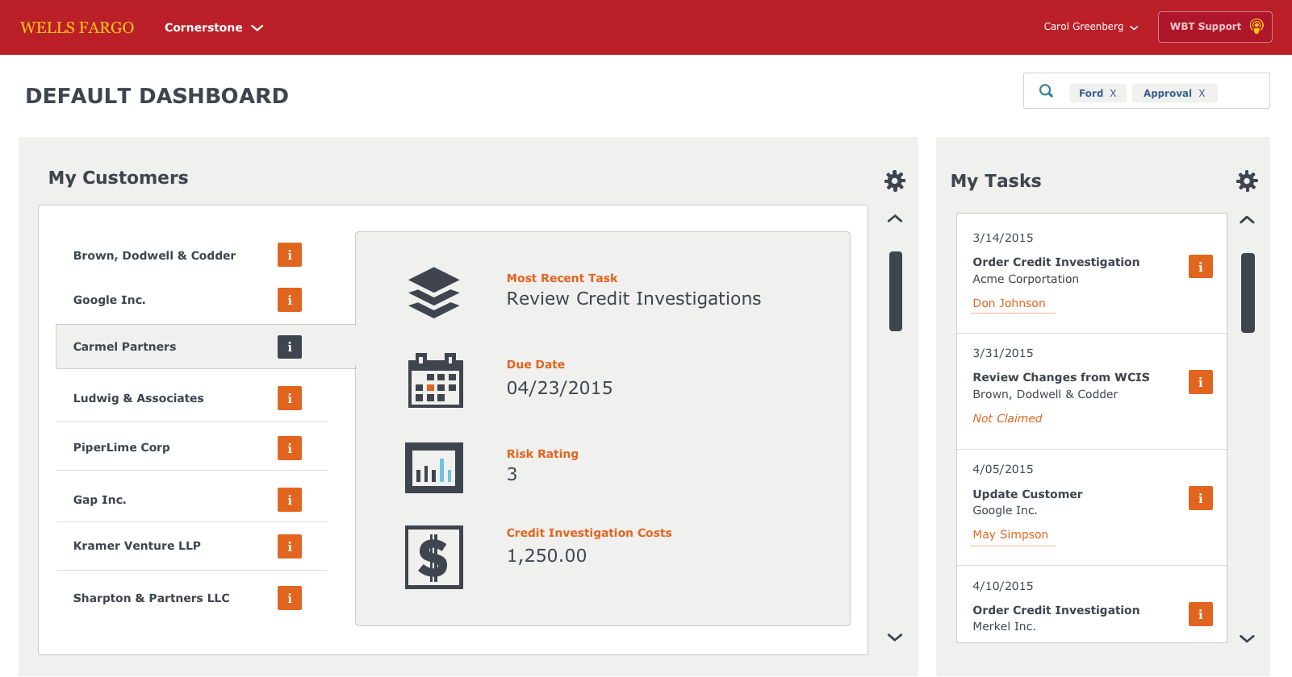
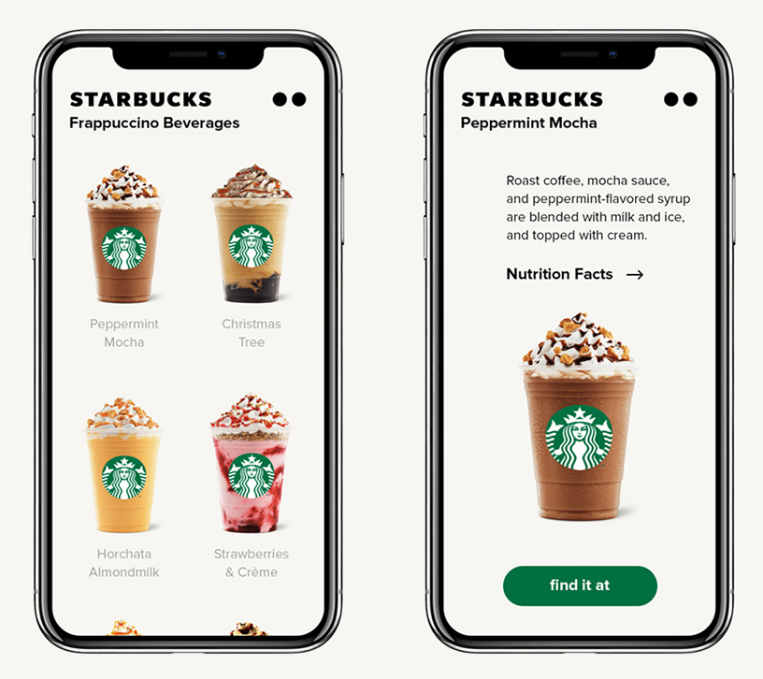
Process
The service delivery and operating systems.
Firms can provide either a higher standardized production-line approach or a flexible and customizable approach.
Source: Carol-Greenberg
Source: Starbucks

Slide 30
Summary
Services have made an impact on the world economy and business practice.
We presented a broad definition and key characteristics of services.
We identified the importance of tangibility vs. intangibility.
We discussed the 7 Ps of Services Marketing.

Slide 31
Discussion Questions
Think of a service job you have had or currently have. How effective, in your opinion, was or is the organization in managing the elements of the service marketing mix?
Give me an example of the difference between service offerings and customer service?

